Slide 1
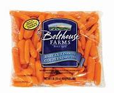
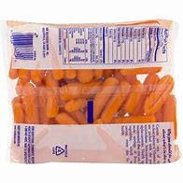
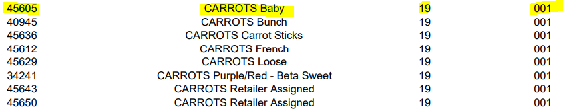

PLU Mapping
All PLUs must be mapped to the product most similar that is listed on the APL. This applies to any fresh fruit and vegetable in Category 19, Subcategory 001
Bagged/Packaged fresh fruit and vegetables with UPC’s will not scan as a WIC authorized food item
  These UPC’s must be mapped to PLUs in the APL
  Ex. You receive a shipment of Bolthouse Farms bagged baby carrots, which contains a UPC barcode. This UPC must be mapped to a PLU on the APL for baby carrots.
apl.xlsx (state.nj.us)

Slide 2
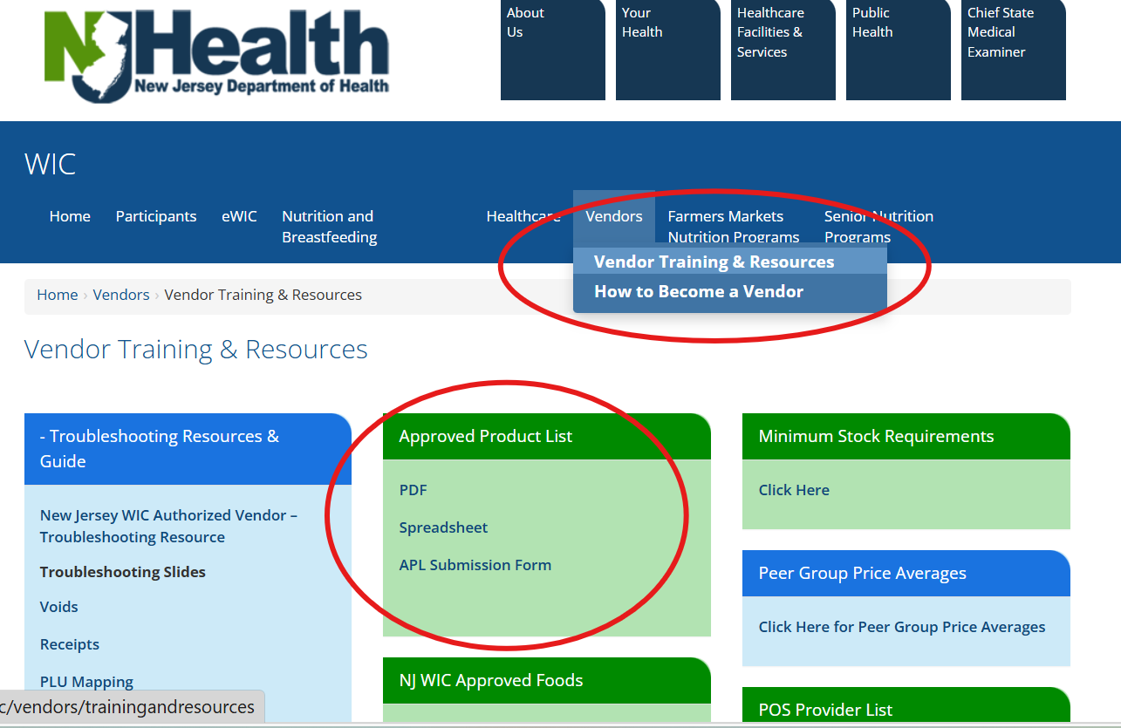
Department of Health | WIC | Vendors Training & Resources (nj.gov)
The eWIC APL link is a reference for NJ WIC Vendors
Use the APL for PLU mapping of fruits and vegetables
Verify if an item is WIC approved
If you believe an item should be added to the APL, you may fill the UPC Submission Form for consideration

